Slide 1
What influences insurance charges?
Jake Rastberger, Shawn (Yixiao) Deng

Slide 2
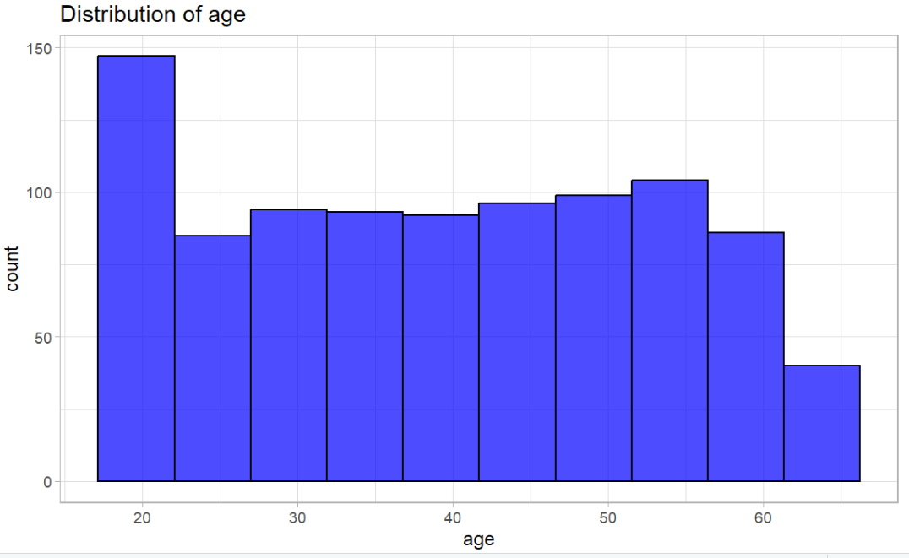
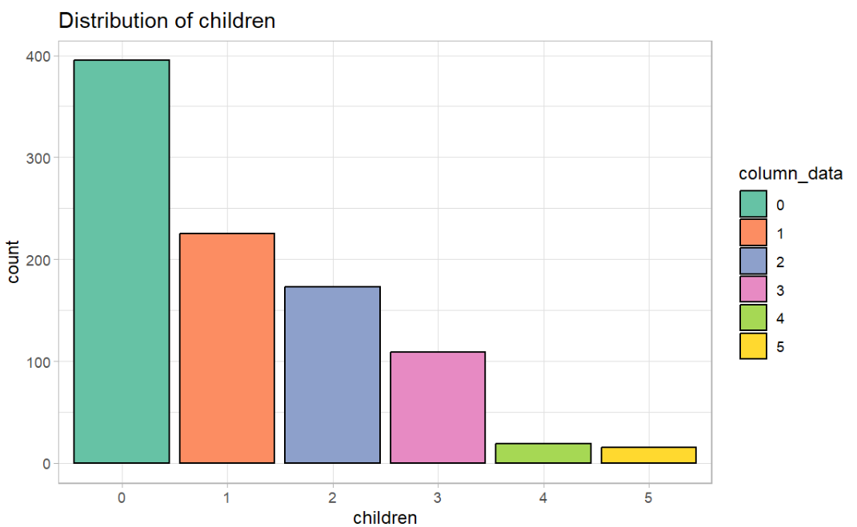
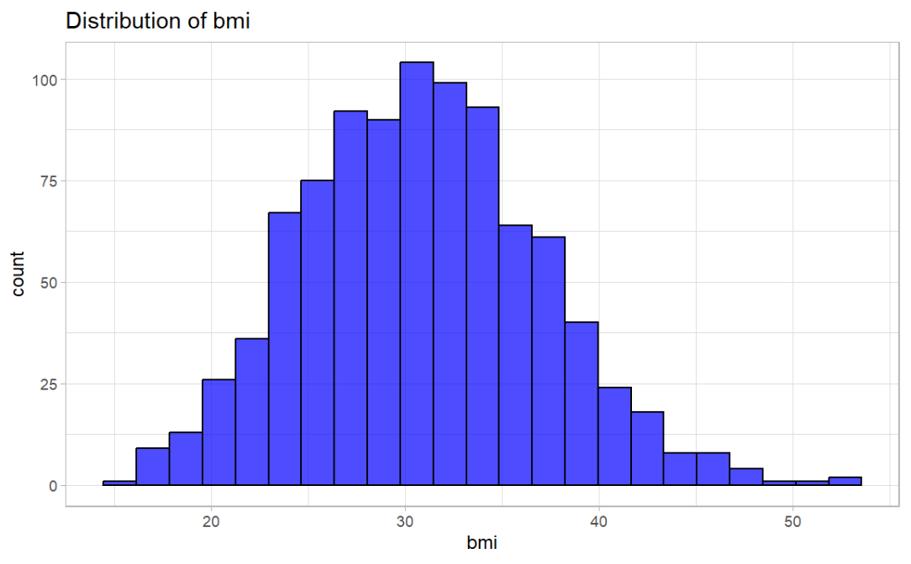
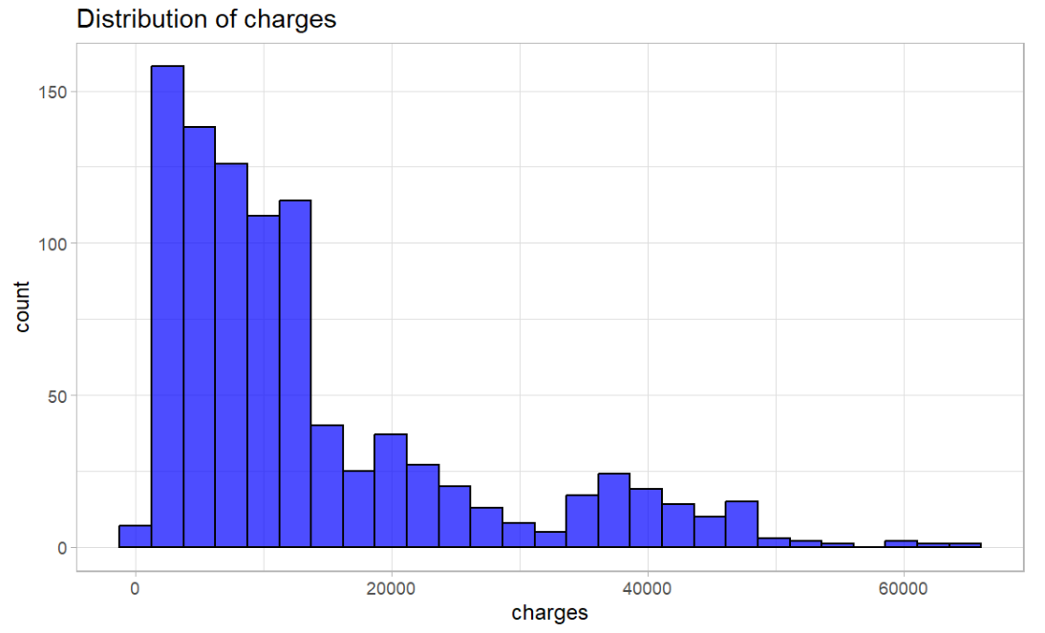
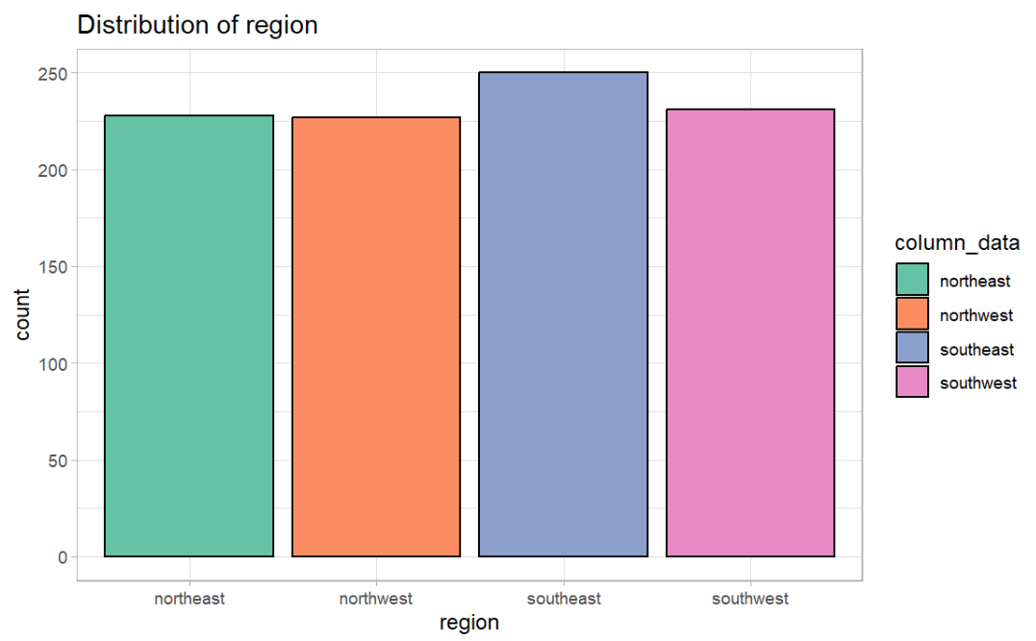
EDA (part 1)
We did a test / train split, that is 7:3.
The distribution of age, sex and region is very uniform, distribution of bmi is very normal.
Distribution of children and charges is heavily skewed.

Slide 3
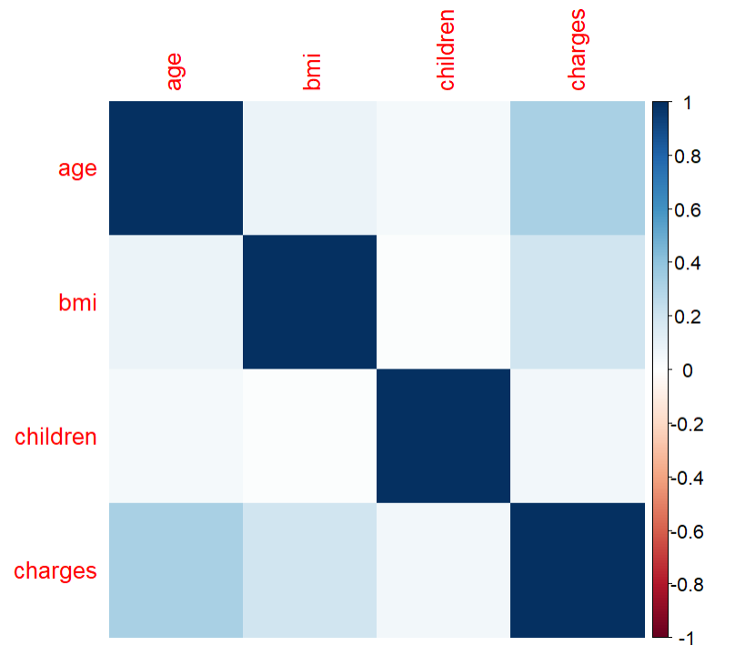
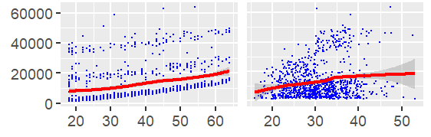

EDA (part 2)
The variables are not correlated, as the plot suggests.
The variable “age” and “bmi” shows a somewhat positive relationship with charge
However we can see distinct groups in both plots showing that some interaction terms may be needed to capture the true relationship between age and bmi with charges

Slide 4
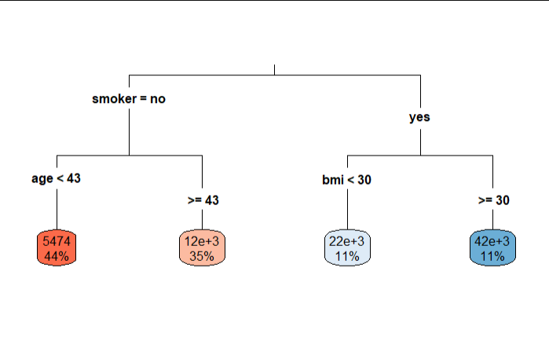
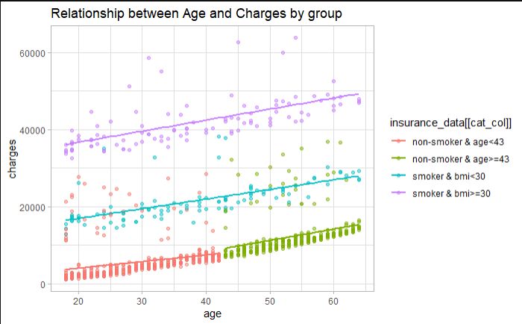
EDA (part 3)
We do see some patterns suggesting some relationships between age, smoker, bmi and charges.
Smokers tend to have higher charges
Bmi makes a distinct difference within the smoker groups. Smokers that have high bmi will increase the charges a lot. Same thing is happening to age as well
This shows us that there are a lot of interaction between smoker, bmi and age. We will keep that in mind for later.

Slide 5
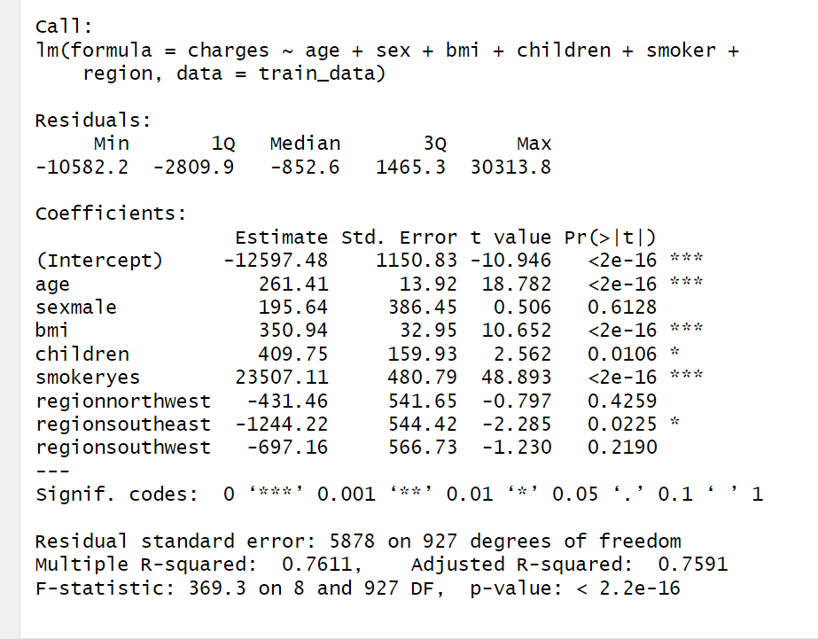
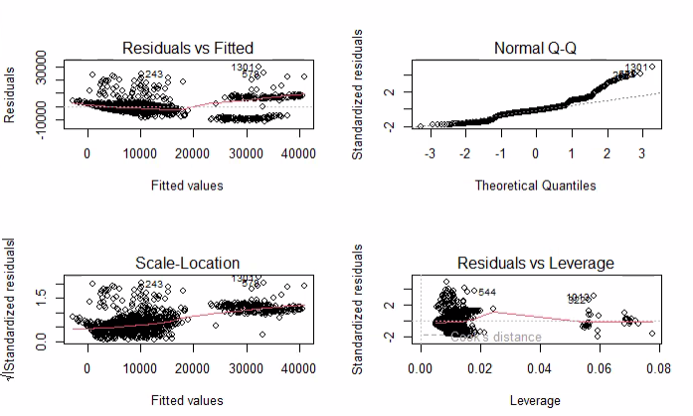
Simple model: simple LM
The first model is the LM model, with all features, no transform.
R² = 0.759
We are concerned about data having constant variance issue. We will dive deeper.

Slide 6
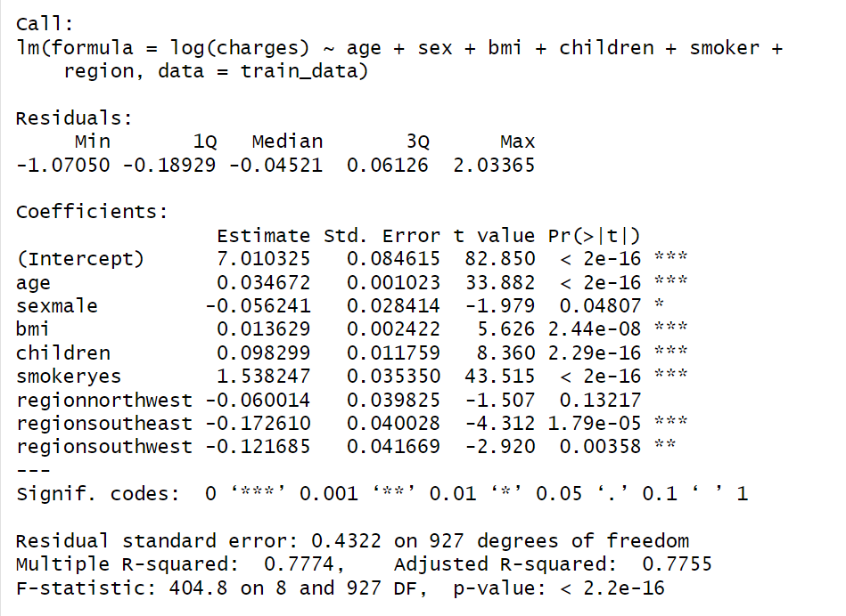
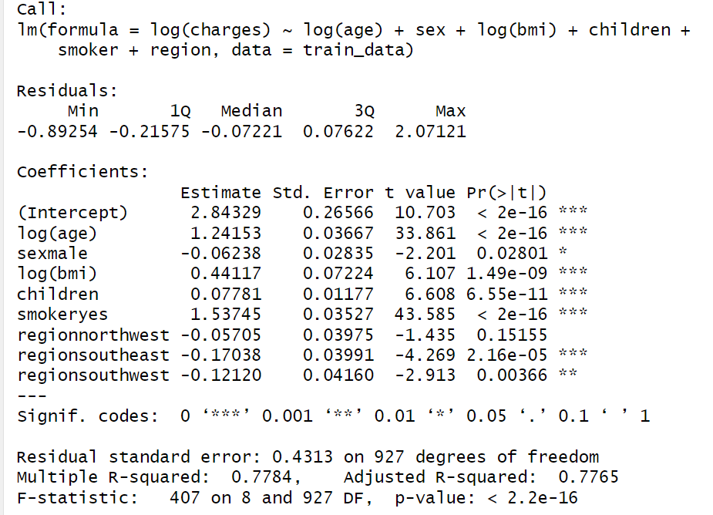
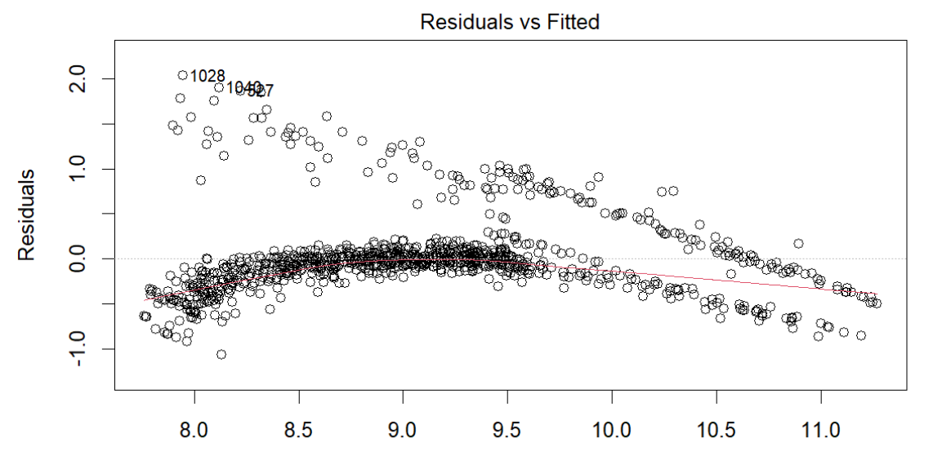
Simple model: Log Transform
We also did LM with Log Transform, one only transformed charge, one transformed all variables.
Log transform gives a higher R² 0.776, but log all variables does not improve too much.
However, the constant variance issue still exists after log transform.

Slide 7
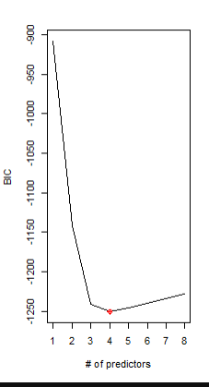
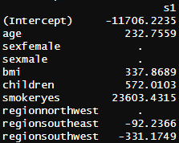
Simple Model: LASSO
LASSO was done to come up with a LM with feature selection.
According to the result, sex and some regions are not making significant differences, but some is.

Slide 8

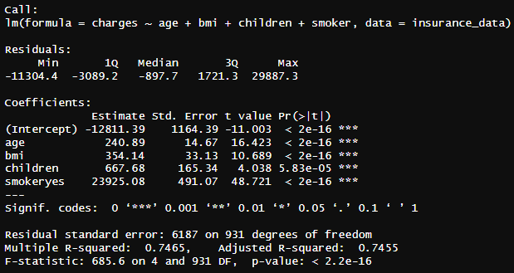
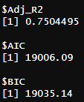

Simple Model: Bootstrap
Bootstrap
We did a bootstrap to bypass the constant variance issue.
R² of a LM using same variables is 0.746, MSE is 33979472
The accuracy of this Bootstrap model is almost identical to the LM using same variables, therefore the accuracy of LM can be used to describe that of the bootstrap.
For example as age increases by 1 year holding all other variables constant based on the data we would expect to see an increase in charges of 240.89.
We think that a practically important increase in charges would be $100 increase in charges as this could affect premiums so we think that all coefficients are both practically and statistically significant.
Linear Model

Slide 9
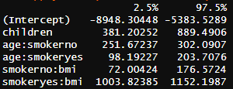
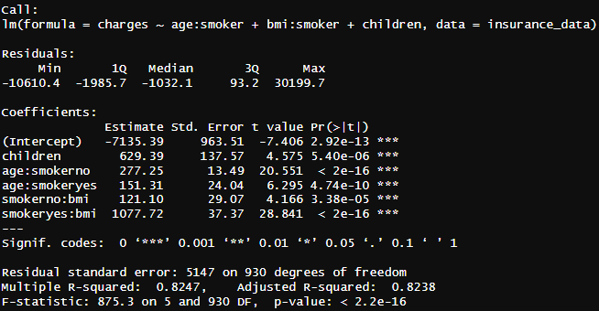
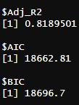

Part 2: Complex model (linear)
Bootstrap
We added the interaction term between age and smoker, as well as bmi and smoker.
We performed a bootstrap for this model as well.
R² is 0.824, MSE from test set is 24590140, both much better than simple LM.
Linear Model

Slide 10
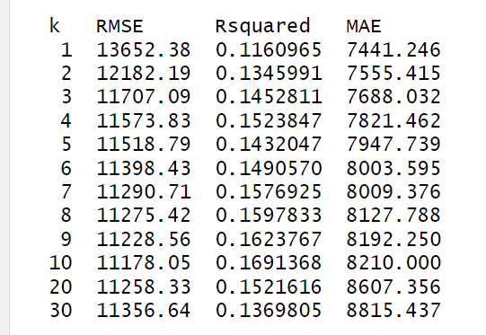
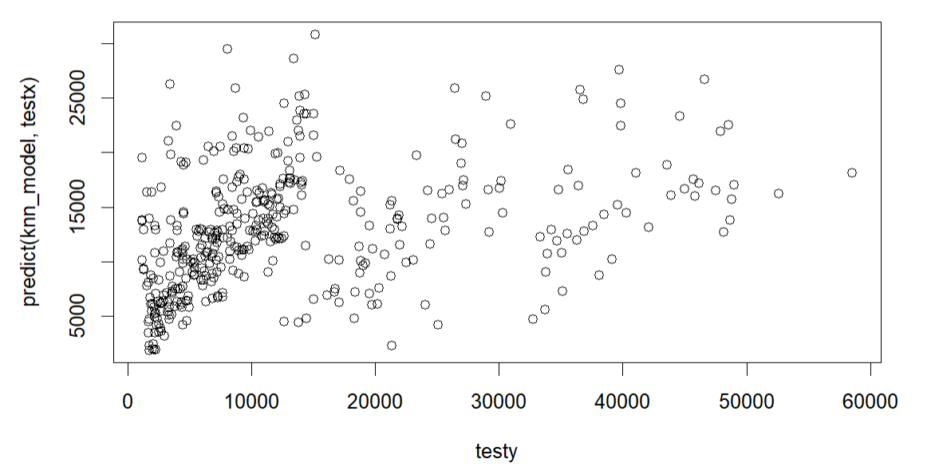

Part 2: Complex model (KNN)
We ran a 10 fold CV to find the best K value.
Based on a overall balance of minimizing RMSE and MAE and maximizing R², K = 6 is ideal.
MSE from test set is 246795.8, much better than other models

Slide 11
Conclusion
Overall the best model we have is the KNN model judging by the MSE.
Age, children, smoker and bmi are the most impactful variables.
Other possible solution for this might be a Regression tree.

Slide 12
Appendix

Slide 13
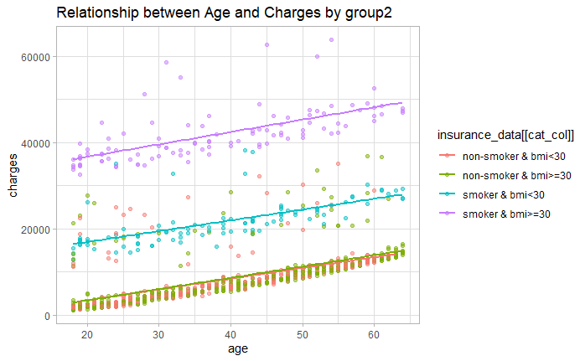
BMI explains smoker but not non-smoker
Just wanted to highlight that the regression tree found that smoker and BMI almost perfectly describes the “third group” in age vs charges but non-smoker and BMI is not what explains the non-smoker section of the “third” group.
With more time we might be able to understand this relationship but given the time constraint we moved forward with just adding interaction terms between the variables.

